Slide 1
Conceito APD ODA from members of the OECD’s Development Assistance Committee (DAC) totalled USD 152.8 billion in 2019, a rise of 1.4% in real terms from 2018, according to preliminary data collected from official development agencies. Bilateral ODA to Africa and least-developed countries rose by 1.3% and 2.6% respectively.
ODA Flows to the DAC List of ODA recipients (countries and multilateral development institutions)
O
“Official”: Provided by official agencies, including state and local governments, or by their executive agencies
D
“Developmental”: Administered with the promotion of the economic development and welfare of developing countries as its main objective
A
“Assistance”: Concessional in character. Provided in the form of grants or soft loans.

Slide 2
O que está excluído da APD?
Commercial objectives
Military objectives
Foreign policy objectives
Religious objectives
Counter-terrorism
Promotion of language or culture of the providing country (including support to the diaspora)
Activities incurred in connection with friendly or cultural exchange schemes

Slide 3
Overview of resource flows covered in OECD-DAC statistics
 | Concessional | Non-concessional
Official | Official development assistance (ODA) --grants --concessional loans --technical assistance | Other official flows (OOF) --non-concessional loans (e.g. by DFIs) --investment-related transactions --export-related transactions -- grants for commercial/representational purposes;
Private | NGO, foundation and other charitable flows | Private flows at market terms --FDI and portfolio investment --export credits --bonds

Slide 4
Eligibility of COVID-19 activities check WP-STAT doc
Frequently asked questions on the ODA eligibility of COVID-19 related activities – Preliminary guidance, pending assessment of concrete activities and initatives and further discussions among members
All direct support to developing countries to fight the pandemic and invest in recovery counts as ODA.
The costs of providing vaccines/tests/treatments to developing countries are eligible as ODA.
General Research for developing a vaccine/tests/treatments for COVID-19 does not count as ODA. General rules on research: research into the problems of developing countries (that disproportionally affect people in developing countries) is ODA-eligible. Eligibility of medical research activities is currently under discussion by the DAC
Co-operation on COVID-19 with health research institutions in developing countries.
It counts as ODA as long as it strengthens the capacity of developing countries to conduct their own research.
Support for epidemiological surveillance and research in a developing country to keep this country’s health authorities informed of status of the pandemic and to control the spread of the disease in the country would also count as ODA.
Research focused on developing countries, e.g. studying the specificities of COVID-19 spread in Africa counts as ODA.

Slide 5
TOSSD
Working Definition
“The TOSSD statistical measure includes all officially-supported resource flows to promote sustainable development in developing countries, to support development enablers and to address global challenges at regional or global levels.”

Slide 6
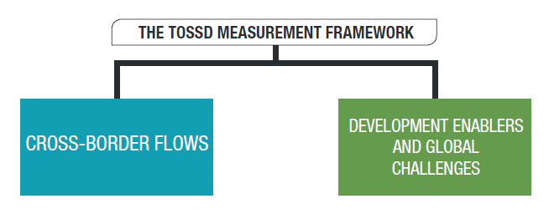
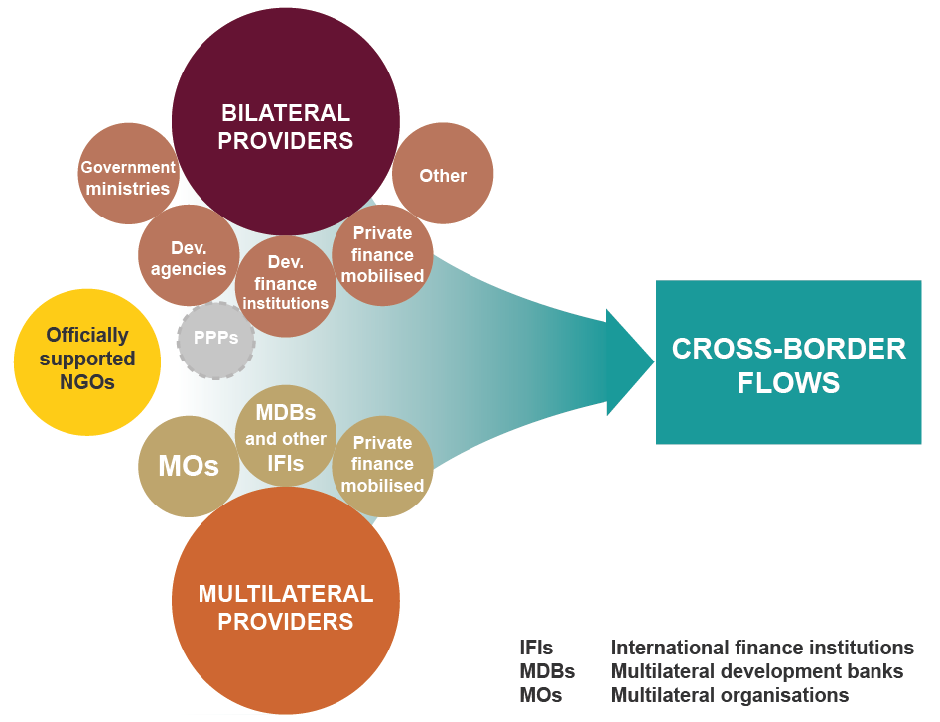
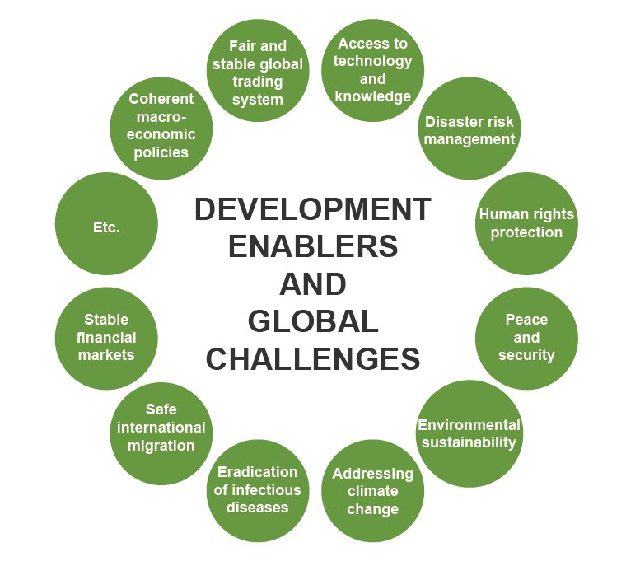
TOSSD TWO-PILLAR FRAMEWORK
Resources to developing countries
Global level expenditures

Slide 7
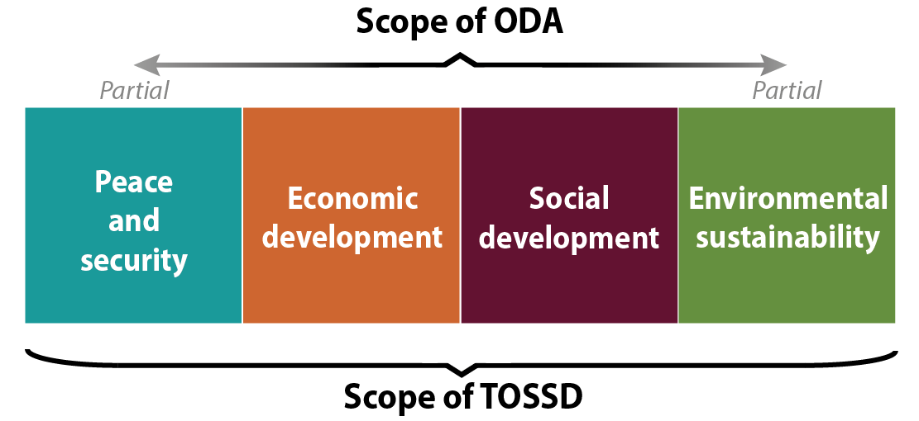
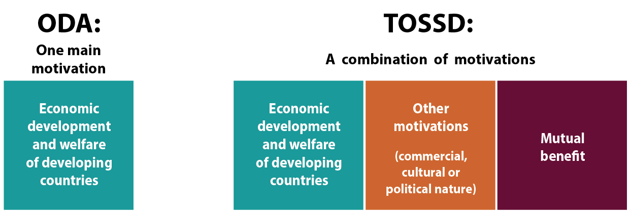
Main Differences between ODA and TOSSD
Larger purpose
All providers of development finance
Broader motivations

Slide 8
1. What is TOSSD?
A framework to measure resources in support of Sustainable Development
TOSSD reporters
Resources considered
Sustainability test
TOSSD framework
Official Development Assistance (ODA) flows
Bilateral providers
(DAC, other bilateral providers, South-South, Triangular)
Pillar I
Cross-border flows to TOSSD-eligible countries
Private Finance Mobilised
Other Official Flows
(OOF)
South-South
co-operation
Does it support Sustainable Development?
YES
Pillar II
Global and regional expenditures for International Public Goods
Multilateral providers
(MDBs and other IFIs, UN agencies, other multilateral organisations)
Triangular
co-operation
Pillar I
Spending for International Public Goods (IPGs)
NO
Private finance mobilised by official interventions
Excluded
Current data availability
complete
partial
not available

Slide 9
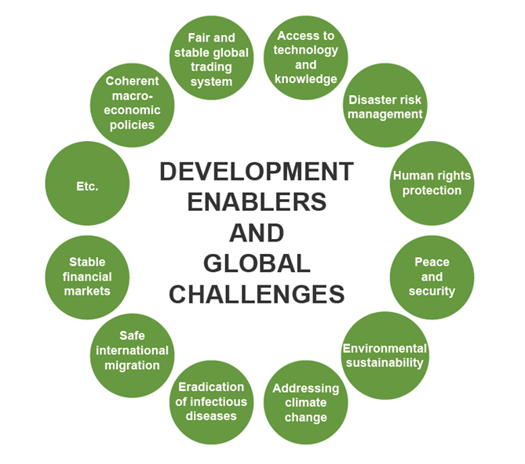
2. Why is TOSSD Pillar II needed? Reflecting the importance of International Public Goods for sustainable development
One of the core features of the SDGs is their universality
International Public Goods are key enablers of sustainable development, including in developing countries
To valorise all aspects of the 2030 Agenda, for example work generating global norms that benefit all countries
To valorise domestic action for global sustainable development

Slide 10
4. Main differences between ODA and TOSSD
TOSSD | ODA
Objective of the measure
Measuring resources in support of sustainable development | Measuring donor effort
Key eligibility criterion of the measure
Sustainable development | Economic development and welfare of developing countries (main objective)
Main focus
Recipient | Provider
Scope of flows covered
Officially-supported resources: official resources and private finance mobilised through official interventions | Official resources
Concessional and non-concessional | Concessional
Measurement
Cash flow | Grant equivalent
Target countries
DAC List of ODA Recipients and other countries on an opt-in basis | DAC List of ODA Recipients
Reporters
Ambition: All providers | DAC and some non-DAC countries
Governance arrangements
Ambition: driven by the international community through the UN | DAC-driven

Slide 11
Shifting sector priorities
Increasing the proportion of ODA directed towards the health sector, but at the expense of other sectors
Changes in the share of total bilateral ODA to sectors (January–September 2019 and 2020)

Slide 12
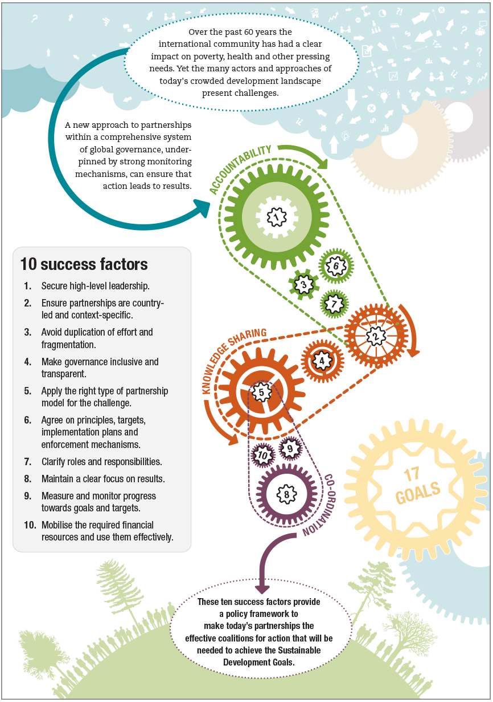
Parcerias
Sociedade Civil
Fundações – 7.8 mil milhões
Sector Privado

Slide 13
Useful links for Development Finance Flows
http://www.oecd.org/dac/
http://www.oecd.org/dac/financing-sustainable-development/
http://www.oecd.org/dac/financing-sustainable-development/development-finance-standards/
http://www.oecd.org/dac/financing-sustainable-development/development-finance-data/
http://stats.oecd.org/qwids/
http://www.tossd.org

Slide 14
Strategies and Policies for engaging private sector in development co-operation
Notes:
Session 1. Session 1. Strategies and Policies for engaging private sector in development co-operation 09:10-10:10 (Paris time)
Private sector engagement: rationale, strategies, lessons and challenges
Paul Horrocks, Manager, Private Finance for Sustainable Development, Financing for Sustainable Development, Development Co-operation Directorate, OECD
Karin Maasel, Head of Africa Bureau, Estonian Centre for International Development
Anna-Greta Tsahkna, member of the Board, Estonian Union of IT enterprises
Agne Kuimet, Round Table for Development Cooperation
Discussion points
Why is the involvement of the private sector necessary and what does it mean for development actors? What are the different ways to involve the private sector? What are the different roles of private actors in development cooperation (eg implementer, beneficiary, co-financier, investor, etc.)?
What are the good practices or principles for involving the private sector in development cooperation? What are the challenges and areas of focus (eg CSR principles, market distortions)
What are some examples and lessons learned from procedures for raising awareness among private actors and for development cooperation activities?
What are the roles of civil society in PSE in development cooperation? How can development cooperation promote partnerships between civil society and private actors?
What are the expectations and opportunities of the Estonian private sector to engage in development cooperation activities?

Slide 15
WHAT WE WILL TALK ABOUT
Why is private sector engagement necessary and what does that mean for development co-operation providers?
What are the different ways of doing private sector engagement? What are the different roles of private sector actors in development co-operation?
What are good principles in engaging with the private sector in development co-operation?
What are some challenges and areas of attention?
What are the different forms of engagement of the private sector?
Notes:
https://www.enterprise-development.org/wp-content/uploads/StrategiesStateoftheArt.pdf

Slide 16
MODERNISING ODA
New approach “shifting the trillions” is required to align broader actors and resources in support of sustainable development.
Better policies for a more transparent and efficient financing for sustainable development: mobilization, impact and transition.
Notes:
1) Why is private sector engagement necessary and what does that mean for development co-operation providers?
With only ten years until the 2030 Agenda, we are way off target. At present, there is a 2.5 billion USD financing gap which has increased, almost doubled as the COVID-19 pandemic exacerbated pressures on economies and societies.
We are in the decade of delivery and thus private finance will be crucial to achieving the Sustainable Development Goals (SDGs).
According to OECD statistics, 257.6 billion USD was mobilised from the private sector by official development finance interventions 2012-2019. The data shows an upward trend between 2012 and 2018, followed by a 9% decrease in 2019.
New models are needed to fund, deliver and scale innovative solutions to social, environmental and economic challenges. A change in paradigm towards “shifting the trillions” is required in order to align broader actors and resources in support of sustainable development.
Better policies for a more transparent and efficient financing for sustainable development must take into account three imperatives: mobilization, impact and transition.

Slide 17
PRIVATE SECTOR ENGAGEMENT (PSE)
‘an activity that aims to engage the private sector for development results, and involves the active participation of the private sector’
Source: OECD (2016) Private Sector Engagement for Sustainable Development, Lessons from the DAC
Notes:
The private sector as an equal partner with finance, ideas and capacity to reach the SDGs
Private investors and finance providers, sovereign wealth funds and pension funds, to multinational companies, domestic firms, micro-, small and medium sized enterprises, in particular also in the informal sector, and business associations and networks, social enterprises, cooperatives, etc.
Also entails partnerships with other actors – CSOs, research institutions, trade unions, and international orgs.
It is therefore a means to an end. The central aim of private sector engagement (PSE) through development co-operation is to leverage the innovation potential of, and additional finance from the private sector to achieve development objectives while simultaneously recognising the need for financial return for the private sector. The private sector is seen as an equal partner with finance, ideas and capacity to reach the SDGs.
DAC members are at different stages in terms of the extent to which they engage the private sector in development co-operation. Some members have been engaging for decades, while for others, private sector engagement is a relatively new endeavour. As such, DAC members take different approaches in policy frameworks for private sector engagement. Some members have no dedicated policy on private sector engagement, others have one or very few policies, while others have a wide range of policies that cover different forms of private sector engagement. Some DAC members have policies that specifically target private sector engagement, while others incorporate private sector engagement as part of a private sector development strategy.
Where sound business enabling environments exist, there is less need for government support to the private sector

Slide 18
OBJECTIVES OF PSE
Leveraging private sector funds and capacities toward development-oriented investments
Promoting collaboration between domestic and partner country private sector actors
Promoting private sector development in partner countries.
Source: OECD (2016) Private Sector Engagement for Sustainable Development, Lessons from the DAC
Notes:
A survey ran in 2016 among DAC members revealed three main objectives in DAC members’ PSE policy frameworks:
Leveraging private sector funds and capacities toward development-oriented investments
Promoting collaboration between domestic and partner country private sector actors;
Promoting private sector development in partner countries.
These objectives are not mutually exclusive and many DAC members seek to promote all three.
Depending on the objective, the private sector will also have a different role, being at times as implementer, beneficiary, co-financier or investor.
In terms of the first objective, DAC members are making use of financial mechanisms such as guarantees, debt instruments and grants, implemented by themselves or other partners, to promote development-friendly investments in partner countries in a range of sectors. The objective of leveraging the private sector is therefore about engagement with the private sector to realise development outcomes through a range of sector-agnostic tools in line with the SDGs framework.
In terms of the second objective, business-to-business schemes are used to promote collaboration between domestic and partner country private sector actors. These schemes typically provide financial and technical support for business-to-business partnerships.
Finally, many DAC members include the promotion of private sector development alongside private sector engagement in their strategies. These approaches include activities directed at establishing sound business environments, addressing market failures, and supporting individuals and businesses to effectively engage in the economy. Strategies for private sector development often include financial and non-financial forms of private sector engagement, such as financial support and capacity development for private sector partners in partner countries, as well as knowledge and technology transfer programme
Follow-up question: Can you tell us more about how to maximize effective private sector engagement? What are the key issue areas?
MORE INFO:
Overall, in 2016, 15 DAC members had specific policy frameworks or strategies to engage the private sector. Another seven DAC members refer to private sector engagement in broader policy documents or on their websites, though have not made available a formal strategy. Generally speaking, these frameworks outline DAC members’ ambition to harness the private sector’s finance, innovation and know-how through strategies that capitalise on the alignment of development and commercial objectives

Slide 19
DIFFERENT FORMS OF ENGAGEMENT
1. Partnerships with companies
Policy dialogue
Knowledge sharing and relationship-building
Capacity building, technical assistance, financial support
2. Innovative financing
Mobilising additional (commercial) finance for development: Blended Finance
Deploying private capital towards development outcomes: Impact Investing
Notes:
Innovative Finance may refer to strategies for mobilising additional private finance and/or for making more effective use of existing funds for development by engaging with private investors, funds or financial institutions. Three specific concepts that feature frequently in discussions on innovative finance include

Slide 20
PART 1 – PARTNERSHIPS WITH COMPANIES
Policy dialogue → Japan’s Public-Private Dialogue on Economic Development
Knowledge sharing and relationship-building → Netherland’s PPP Lab
Capacity building → Germany’s Chambers and Associations Partnership Programme KVP
Technical assistance, financial support → Czech Republic’s B2B programme
Notes:
Example. Japan’s “Public-Private Policy Dialogue on Economic Development”
Recognizing the importance of private actors to achieving 2030 agenda in developing countries, the government of Japan regularly holds the strategic dialogues with private and public actors active in development co-operation. The dialogue consists of public entities such as Ministry of Foreign Affairs, Ministry of Finance, Ministry of Economy, Trade and Industry, Japan International Cooperation Agency and Japan Bank for International Cooperation, and private actors including the Chamber of Commerce and Japan Business Federation. Through the dialogue, public and private actors share their experience acquired in developing countries and apply them to further discussion on policy making to engage more private actors in development co-operation.
Knowledge and information sharing. Example: Netherland’s PPP Lab, mandate by the Dutch Government to generate knowledge and methodological lessons from and on PPPs that can be used to improve policy and implementation. Focuses on business models, scaling up and system change, governance and government and partnership performance tracking.
Example. Germany’s Chambers and Associations Partnership Programme (KVP)
The Chambers and Associations Partnership Programme, funded by the German Federal Ministry for Economic Cooperation and Development (BMZ) aims to support and connect German chambers and business associations with partners in developing countries. The programme harnesses the experience of German private sector actors into development co-operation activities. Furthermore, by improving the quality of industries in developing partner countries, the local business environment can become more attractive for private companies in making FDIs, which can lead to further economic development of the beneficiary countries.
ANNEX:
Soft Tools, such as:
Knowledge and information sharing. Example: Netherland’s PPP Lab, mandate by the Dutch Government to generate knowledge and methodological lessons from and on PPPs that can be used to improve policy and implementation. Focuses on business models, scaling up and system change, governance and government and partnership performance tracking.
Policy dialogues, like Japan’s Public-Private Dialogue on Economic Development.
Technical Assistance, like Czech Republic’s B2B programme, which serves to lower the engagement barrier.
Capacity Development, like Germany’s Chambers and Associations Partnership Programme KVP.
Knowledge and information sharing. Example: Netherland’s PPP Lab, mandate by the Dutch Government to generate knowledge and methodological lessons from and on PPPs that can be used to improve policy and implementation. Focuses on business models, scaling up and system change, governance and government and partnership performance tracking.
Policy dialogues, like Japan’s Public-Private Dialogue on Economic Development.
Technical Assistance, like Czech Republic’s B2B programme, which serves to lower the engagement barrier.
Capacity Development, like Germany’s Chambers and Associations Partnership Programme KVP.

Slide 21
PART 2 – FINANCING FOR DEVELOPMENT
Blended Finance
Social Impact Investing
Notes:
Number of impact investors rose from fewer than 50 pre-1997 to well over 200 in 2017
SII assets under management represents 228.1billion USD, 56% of which was allocated in emerging markets
BUT, there is a concrete risk of impact washing. Crowded space with diverse definitions.

Slide 22
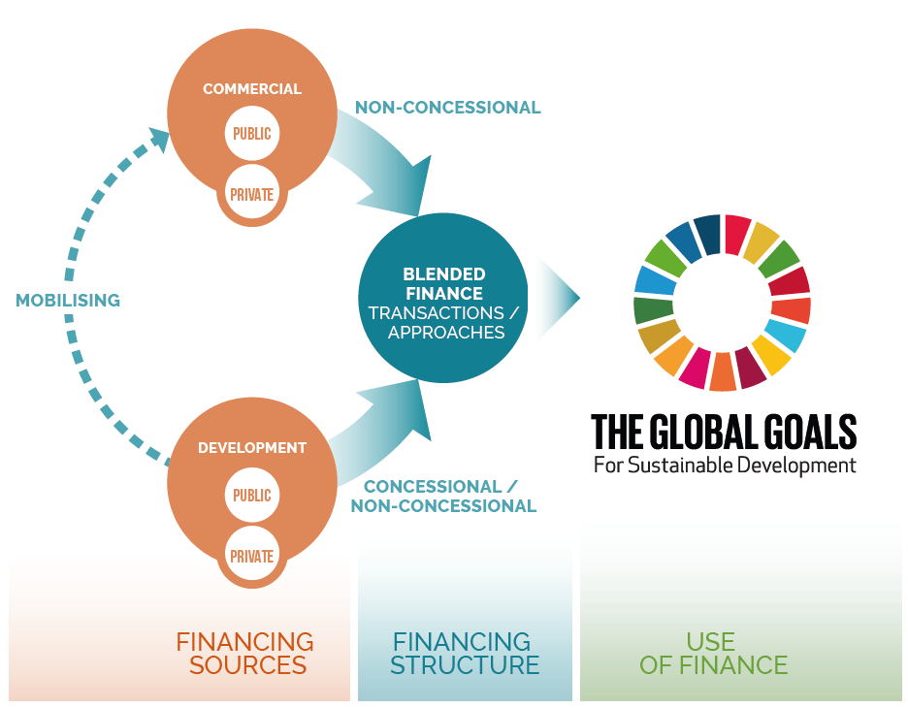
WHAT IS BLENDED FINANCE?
Blended finance is the strategic use of development finance for the mobilisation of additional finance towards sustainable development in developing countries
Source: OECD (2018), Making Blended Finance Work for the Sustainable Development Goals
Notes:
Blended finance is emerging as an important set of financial instruments to help mobilise private financing for development priorities in developing countries and is a critical strategic policy approach that governments can take in response to the Addis Abba Action Agenda. The OECD has framed blended finance as the strategic use of development finance for the mobilisation of additional finance towards sustainable development in developing countries. The focus is primarily on crowding-in additional commercial finance that is not currently deployed to support development outcomes. Blended finance does so by helping to overcome systemic bottlenecks and project level viability gaps, which is critical in narrowing the substantial financing gap.

Slide 23
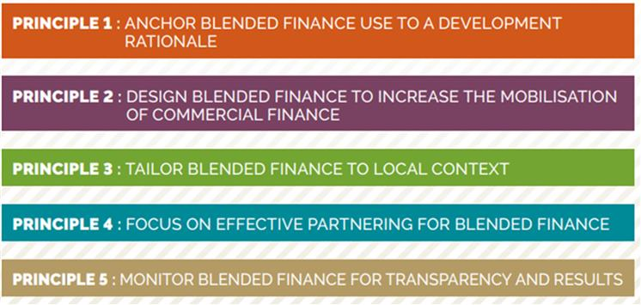
WHAT IS BLENDED FINANCE? BLENDED FINANCE PRINCIPLES
OECD DAC Blended Finance Principles present a blueprint for better blending policies, aimed primarily at DAC donors
Notes:
PF4SD Work programme
Gathering additional evidence on specific contexts, sectors and instruments
Better understanding the impact of investment in development co-operation
Building policy guidance: The Tri Hita Karana Roadmap for Blended Finance
Convening the community of practice
THK
To capitalise on the collective strength in mobilising commercial capital towards the SDG-related financing gap, blended finance actors are engaging in a coordinated effort to ensure the effectiveness and scaling up of blended finance operations. Approaches to blended finance have evolved over different periods of time at varying speeds and in response to diverse actors and stakeholders.
The goal is to work together, in parallel with the innovative and evolving investment environment, in order that the 2030 agenda can be effectively delivered. Beyond scaling up commercial investments in the development finance spectrum, blended finance providers and recipients must collectively champion the application of high standards and shared values throughout the financing process.
The shared value system on blended finance promotes that stakeholders act coherently within established and existing blended finance frameworks by finding a common language. Having a common language will reinforce actions both at the policy level as well as at the operational level. In doing so, the common value system will work as a means to building on existing governance mechanisms within a value driven framework. The shared value system aims to set a framework for common values for all actors working to scale their blended finance operations and improve their effectiveness
OECD DAC Principles:

Slide 24
BLENDED FINANCE MECHANISMS AND INSTRUMENTS

Slide 25
SOCIAL IMPACT INVESTING
Social impact investing provides finance to organisations addressing social and/or environmental needs with the explicit expectation of a measurable social, as well as financial, return. It thus aims to foster economic development while achieving social outcomes.
Notes:
It is one way of channelling more resources towards the Sustainable Development Goals (SDGs).

Slide 26
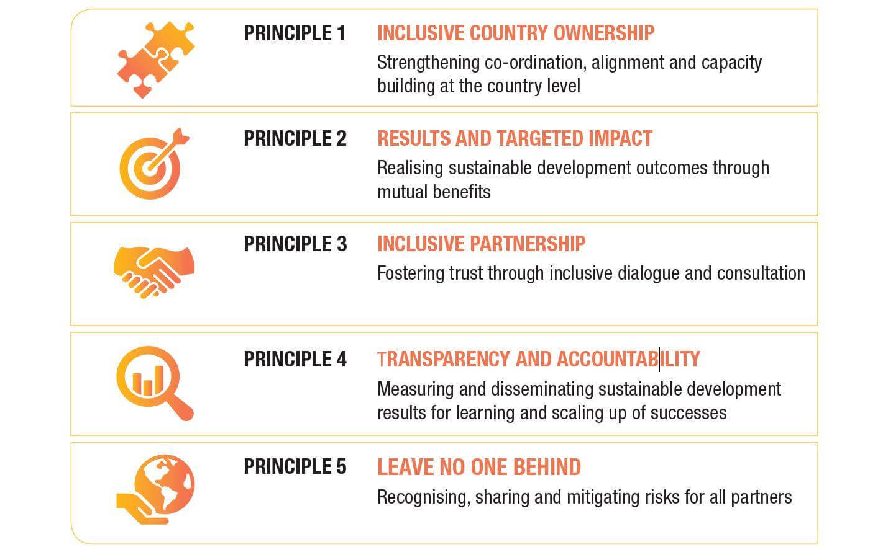
PRINCIPLES FOR EFFECTIVE PRIVATE SECTOR ENGAGEMENT
Notes:
3) What are some good practices or principles in engaging with the private sector in development co-operation?
As we have seen when defining PSE, development results, in particular the realisation of the Sustainable Development Goals, should underpin private sector engagement portfolios. Engagement mechanisms should be aligned to overall development co-operation priorities at national and partner country level, in terms of themes, sectors and countries of focus. Also, the decision to partner with the private sector should be rooted in a theory of change that establishes whether and how the private sector is best placed to help realise specific development results.
In March 2019, the Global Partnership for Effective Development Co-operation (GPEDC) has endorsed five, mutually reinforcing Principles for Effective Private Sector Engagement, largely focusing on PSE at country level, reproduced below:
A full description of the principles is available at: https://effectivecooperation.org/wp-content/uploads/2019/06/Kampala-Principles-final.pdf
Follow-up question => Can you tell us more about the principles for private sector engagment? How were they developed? What do they prescribe in more detail?
Following extensive consultations, led by a multi-stakeholder Working Group, with governments, businesses, civil society, trade unions and other actors, and drawing on the advice of a Business Leaders Caucus, the Global Partnership for Effective Development Co-operation (GPEDC) developed a set of principles to guide collective work on making private sector partnerships for development co-operation more effective. The Principles were endorsed by the Steering Committee of the Global Partnership in Kampala, Uganda in March 2019.5 The five mutually reinforcing principles are:
P1 = INCLUSIVE COUNTRY OWNERSHIP Strengthening co-ordination, alignment and capacity building at the country level
1.A Define national PSE goals through an inclusive process
1.B Align and co-ordinate PSE through development co-operation with national priorities and strategies
1.C Invest in capacities for PSE through development co-operation
P2 = RESULTS AND TARGETED IMPACT Realising sustainable development outcomes through mutual benefits
2.A Focus on maximising sustainable development results
2.B Ensure sustainable results by aligning core business and development interests.
2.C Engage in partnerships according to agreed international standards.
P3 = INCLUSIVE PARTNERSHIP Fostering trust through inclusive dialogue and consultation
3.A Support and participate in inclusive dialogue and consultation.
3.B Promote inclusive, bottom-up and innovative partnerships and raise awareness of engagement opportunities.
3.C Make partnerships more accessible.
P4. TRANSPARENCY AND ACCOUNTABILITY Measuring and disseminating sustainable development results for learning and scaling up of successes
4.A Measure results.
4.B Disseminate results
4.C Ensure accountability
P5. LEAVE NO ONE BEHIND Recognising, sharing and mitigating risks for all partners
5.A Ensure that a private sector solution is the most appropriate way to reach those furthest behind.
5.B Target specific locations, markets, value chains and investor types that are most likely to have a positive impact on those furthest behind.

Slide 27
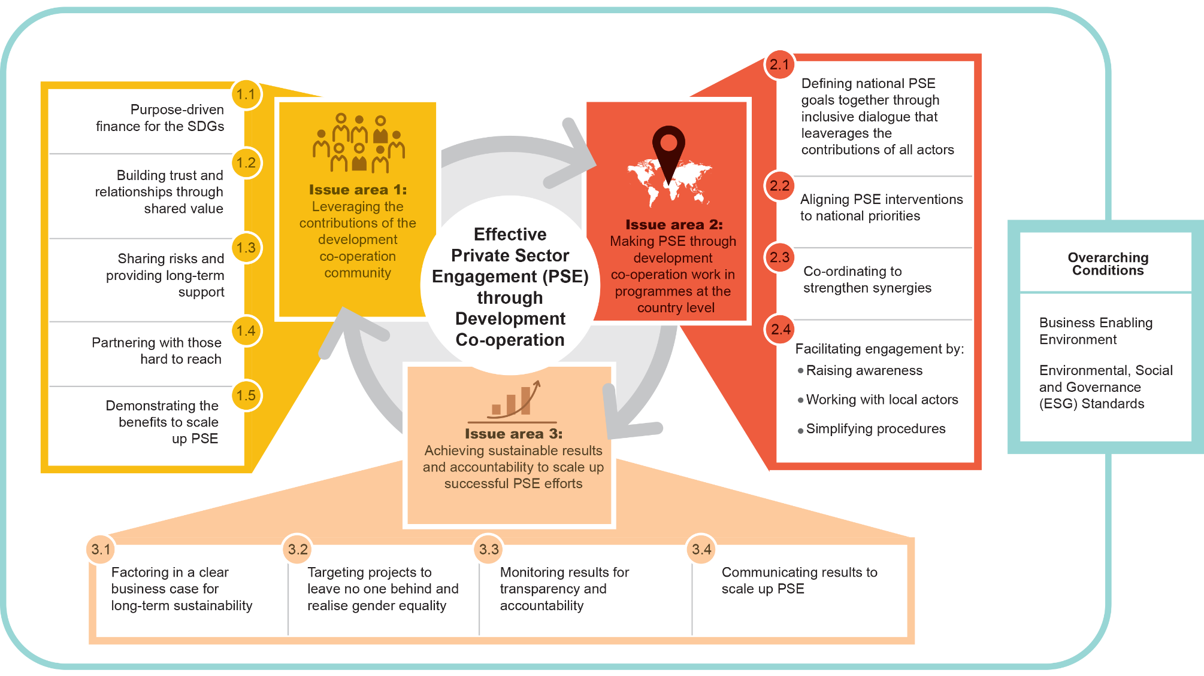
ISSUE AREAS FOR PSE
Source: GPEDC
Notes:
Follow-up question: Can you tell us more about how to maximize effective private sector engagement? What are the key issue areas?
How to maximize effective private sector engagement? Three issue areas are identified:
Issue area 1: Leveraging the contributions of the development co-operation community
In this area the paper looks at how to successfully leverage the contribution of the development cooperation community.
First of all, development finance needs always to be purpose-driven, sogeared towards attaining sustainable development and helping achieve the 2030 Agenda and the Sustainable Development Goals (SDGs). In this context, development finance can help ensure that PSE activities provide positive contributions from private sector actors.
In addition, it must work to build relationships and trust within a diverse and large community of actors, active across sectors and regions, who are willing to jointly leverage resources and capacities to address challenges in ways that no one actor can alone.
Development finance as an added value in that it provides unique incentives through risk sharing and the provision of longer-term exit strategies compared to other forms of finance, such as finance provided by commercial lenders, and this should always be leveraged when working with private sector actors.
The development co-operation community should also build on the advantage that it can partner with those who are hard to reach or underserved by the market, including by working with micro, small and medium-sized enterprises (MSMEs).
And last but not least, the development cooperation community has a role to play in demonstrating the value of PSE through development cooperation to those that have concerns and mobilising support from taxpayers.
At the country level, development partners do not appear to adequately harness these respective strengths of development co-operation. Going forward, development partners should seek to build trust and incentives for effective partnerships and to demonstrate the value of PSE through development co-operation.
Issue area 2: Making PSE through development co-operation work in programmes at the country level
In this area, the paper highlights that
there is a need for governments to lead in establishing national goals for PSE through development co-operation to support national development priorities and the SDGs. This should be done in an inclusive manner around which development partners can align and co-ordinate their efforts, clarify their roles and priorities, and strengthen synergies.
This also points to the need for ongoing, inclusive public-private policy dialogue at country level, including social dialogue. Development co-operation can play a matchmaking and bridge-building role in this regard.
Development partners and partner countries can facilitate greater PSE by three actions:
raising awareness among businesses of the specific opportunities and benefits, but also the distinct challenges of PSE through development co-operation at the country level.
tailor engagement opportunities to the needs and capacities of the private sector; and
respect differences between various types of private sector partners, such as small versus larger companies, making sure that procedures are simplified for the smaller companies.
Issue area 3: Achieving sustainable results and accountability to scale up successful PSE efforts
As mentioned a few times, PSE through development co-operation should consistently be rooted in the ambition to generate development outcomes and business profits (shared value). This will ensure efforts in PSE projects are focused on realizing sustainable development outcomes through profitable solutions.
Alongside a clear development rationale, development partners should also ensure that the PSE projects they support are grounded in a clear business case for the private sector to ensure success and long-term sustainability.
In defining development results, there is a need to examine how and when to target the most marginalized and those furthest behind – actors in the informal sector, women and youth for example.
Generating and communicating evidence on results achieved through cost-effective, nimble and balanced monitoring and evaluation that addresses development and commercial goals is needed to increase transparency and accountability on the use of public money, promote learning, build trust, demonstrate the value of PSE through development co-operation
GPEDC (2020) Effective private sector engagement through development co-operation
and scale up effective projects.

Slide 28
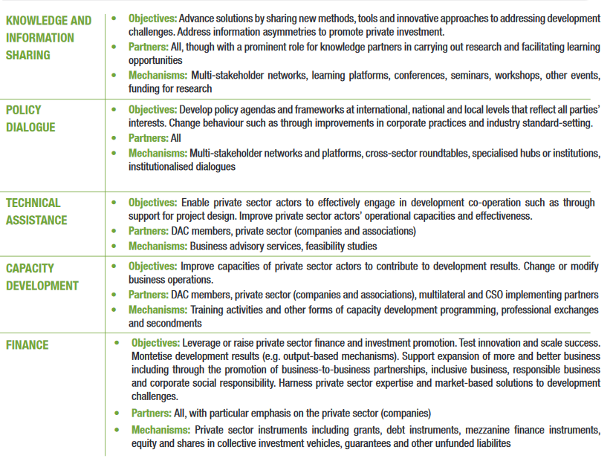
A HOLISTIC TOOLBOX FOR PRIVATE SECTOR ENGAGEMENT IN DEVELOPMENT CO-OPERATION

Slide 29
GOVERNMENT INSTRUMENTS TO PROMOTE RBC
1. LEGISLATION AND REGULATION | Laws, regulations and other legislative instruments are used or being explored by many governments to establish mandatory requirements regarding businesses’ adherence to, and/or reporting on, RBC principles. Legally binding instruments in the widest sense may also include trade agreements between two or more countries; while not explored in detail in this paper, trade agreements have increasingly featured provisions around labour rights, the environment or other aspects of RBC in recent years (e.g. APEC, 2020 and Government of Canada, 2020).
2. FACILITATION AND MOTIVATION | Government actions in this category include a wide range of measures that lead to improved information or incentives for companies to adopt RBC principles. While governments may provide information on how to operationalise legally binding RBC requirements, most measures in this category aim to facilitate or encourage voluntary progress towards RBC. These include, among others, financial support to third-party standard-setting, benchmarking or knowledge sharing initiatives, as well as to organisations that directly seek to influence business drivers of RBC (e.g., consumer or investor awareness of RBC).
3. PARTNERSHIPS AND ENGAGEMENT | Government partnerships and engagement with individual companies or private-sector groups and platforms serve to combine public and private resources and know-how to support the adoption of RBC practices. As opposed to facilitation and motivation, partnerships and engagement therefore involve cost-sharing with the private sector, or active participation of government agency staff in private sector initiatives. While they could be used to support compliance with legal obligations (see Chapter 3.1), they are most commonly used in the context of voluntary efforts towards RBC.
4. PUBLICITY AND ENDORSEMENT | Government actions in this category range from showcasing positive examples of RBC practice to official signs of approval or awards for particular companies that are seen as champions of RBC. Publicity and endorsement are typically reserved for business practices that go beyond any legal requirements and have a particularly high positive impact on social or environmental aspects of their core business.
Source: OECD, 2018
Notes:
Follow-up question => What are Government instruments that can be used to promote RBC?
Drawing on a categorisation of government instruments to promote RBC developed by the OECD (OECD, 2018), a distinction is made between four key types of government actions, as further outlined in the Table on the slide. The OECD’s categorisation distinguishes between regulating, facilitating, partnering and endorsing.
Follow-up question => What are Government instruments that can be used to promote RBC?
Knowledge sharing tools and platforms have been developed to help procurement officers purchase responsibly and identify potential risks in specific sectors and supply chains.
Many donor agencies and DFIs have taken important steps to promote, incentivise and exemplify RBC issues
Donor agencies are increasingly recognising RBC as an important element of their policies.
DFIs have systematic processes in place for ensuring investments are not associated with negative impacts.
Nevertheless, there is scope to harmonize efforts across development finance actors, and mainstream RBC standards within institutions.
For example, as board members, large donors may often have influence on the processes and controls that are implemented by multilateral organisations. Bilateral contributions may also require a certain degree of relinquishing control over funds and may imply sharing responsibilities with other stakeholders such as the recipient government, NGOs, or the private sector (OECD, 2017).

Slide 30
MANAGING RISKS
Potential risks:
Negative market distortion
Raising barriers to market entry
Reinforcing information asymmetries
Reputational risk
Notes:
4) What are some challenges and areas of attention (e.g. Corporate Social Responsibility principles, market distortion)
Source: DCED
A specific risk arising from collaborations with individual companies and investors is negative market distortion (which result in reinforcing the market power of individual companies at the expense of others). Clearly, ‘the whole point of public… [support] is to change (distort) market outcomes that are unsatisfactory” (ODI, 2015). A case in point is the M-PESA, Kenya’s first mobile banking service, which was co-funded by a DFID Challenge Fund. M-PESA positively disrupted the financial service market, enabled the financial inclusion of more than 20 million Kenyans, and has been replicated in 89 countries (UNDP, 2012; Forbes, 2015; GMSA, 2015). Yet, depending on the context and the specific approach (SDC, 2007) any provision of finance, knowledge or networks to individual companies may negatively distort the market and reduce societal welfare (DCED, 2018a). For example, ARTE (2017) documented a public-private initiative in Kenya’s potato sector, which required farmers to buy expensive seeds and pesticides from partner companies each season. As a result, regional seed companies risked being crowded out of the market.
In addition to reinforcing the market power of individual companies at the expense of others, DCED (2018a) identifies two further negative distortion risks: Raising barriers to market entry (e.g. by facilitating too rigorous standards); and reinforcing information asymmetries, or leaving them unresolved (e.g. by compensating individual investors for the lack of market information and heightened risk through blended finance).
In practice, there are no easy answers to avoiding such distortions, as programmes face many trades-off between efforts to make individual partnerships a success and promoting market-wide and long-term solutions. Yet, increased attention to market structures, as practiced by Market Systems programmes, can help to make more informed choices and mitigate distortion risks at each step of the intervention process, e.g. by:
Assessing the market and monitoring interventions, to tackle an actual market failure and avoid displacing market players that would undertake the activity anyway (‘additionality’)
Actively crowding in other market players, once an initial partnership has succeeded, including by publishing information on markets and successful business models;
Working with competition authorities and experts, including to better understand a company’s market power before and during intervention. (DCED, 2018a)
ANNEX:
Embracing private-sector driven development implies that donors assume greater risk, too. Taking risk is inherent to business and the basis for reaping financial rewards. Managing it requires businesses to experiment with new solutions, operate flexibly and respond swiftly to market developments. Donors, whose systems are traditionally aimed at reducing risk and controlling deliverables through tightly managed contracts, are still learning about the full implications of sharing business risk. More than with non-profit entities, they also face additional reputational risks.

Slide 31
SELECTING PARTNERS
Screening potential partners:
Exclusion lists and criteria
Due diligence
Compliance with Responsible Business Conduct (RBC) standards
…without making the process too burdensome!
Notes:
Donors also still use and enhance traditional systems for screening potential partners, including:
Exclusion lists and criteria: Several donors (e.g. Australia, Norway, Sweden) exclude certain industries, project topics and companies from partnerships for development; many also explicitly exclude companies convicted of corruption, fraud or criminal activity (NSI, 2014).
Due diligence: Donor agencies typically assess companies past performance, reputation, financial, social and environmental policies and practices, as well as future plans (USAID, 2019; USAID, 2019a) to review shared ethics, including adherence to responsible business practices.
Compliance with the OECD Guidelines for Multinational Enterprises and the UN Global Compact principles are considered an advantage (NSI, 2014). Responsible business conduct can also be included as a criterion for partnership by stipulating that companies must have environmental, social and governance standards and pay taxes when operating abroad.
According to the OECD, “responsible business conduct (RBC) entails above all compliance with laws, such as those on respecting human rights, environmental protection, labour relations and financial accountability, even where these are poorly enforced. It also involves responding to societal expectations communicated by channels other than the law, e.g. inter-governmental organisations, within the workplace, by local communities and trade unions, or via the press. Private voluntary initiatives addressing this latter aspect of RBC are often referred to as corporate social responsibility (CSR).” (OECD, 2015)
ANNEX:
A key consideration for donors is how to review risks without making the process too burdensome for businesses. This may include using public information as much as possible, and existing due diligence for repeated partners (USAID, 2019a). It is also critical to understand partners’ business needs; agencies may therefore commit to protecting intellectual property and sign non-disclosure agreements on sensitive business information, at least for an agreed amount of time (USAID, 2019).
A key evolution in donor agencies’ approach to managing these risks is an increased focus on effective relationship management with businesses: Clear management and governance structures in partnerships, results-based management, and the flexibility to adjust approaches over the course of engagement are all critical aspects for identifying and addressing potential risks (USAID, 2019).
Source: DCED
Follow-up question => What are Government instruments that can be used to promote RBC?
Knowledge sharing tools and platforms have been developed to help procurement officers purchase responsibly and identify potential risks in specific sectors and supply chains.
Many donor agencies and DFIs have taken important steps to promote, incentivise and exemplify RBC issues
Donor agencies are increasingly recognising RBC as an important element of their policies.
DFIs have systematic processes in place for ensuring investments are not associated with negative impacts.
Nevertheless, there is scope to harmonize efforts across development finance actors, and mainstream RBC standards within institutions.
For example, when donors make multilateral contributions, the funds become an integral part of the recipient institution and assets (Gulrajani, 2016). Nevertheless, as board members, large donors may often have influence on the processes and controls that are implemented by multilateral organisations. Bilateral contributions may also require a certain degree of relinquishing control over funds and may imply sharing responsibilities with other stakeholders such as the recipient government, NGOs, or the private sector (OECD, 2017).
Donors should screen potential partners to guarantee that they abide to the highest possible level of responsible business conduct. This is valid in all private sector engagement initiatives.
Donor agencies typically assess companies past performance, reputation, financial, social and environmental policies and practices, as well as future plans to review shared ethics, including adherence to responsible business practices.

Slide 32
ANNEX

Slide 33
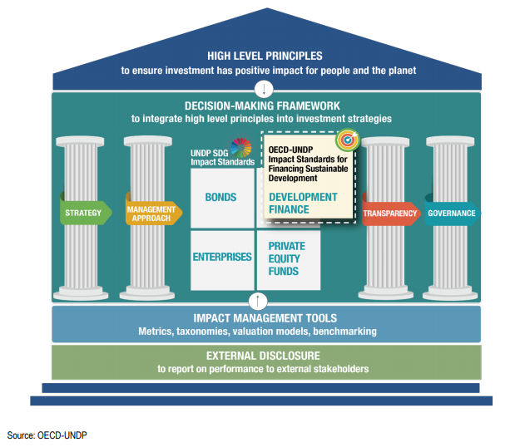
HOW IS-FSD FIT WITH EXISTING PRINCIPLES, FRAMEWORKS AND TOOLS
Notes:
One of the way to screen partners and identify those that aim to give a positive contribution to the SDGs is by checking whether they have a strong focus on achieving development results in the strategy, management approach, transparency provisions and governance.
To support donors in this process, in close collaboration with the UNDP, the OECD has developed the Impact Standards for Financing Sustainable Development (IS-FSD). The Standards are designed to support donors in the deployment of resources through DFIs, private asset managers and other private sector partners, in a way that maximises the positive contribution towards the SDGs.
These Standards constitute a best practice guide and self-assessment tool, and are freely available for subscription on a voluntary basis. They act as a framework for all organisations with a desire to demonstrate public accountability regarding their measurement and management of impact.
The IS-FSD are developed to bridge the needs of the donors on one side and the investors and DFIs on the other side, and provide a common framework for dialogue between parties.
The structure of the Standards is depicted on this slide. As you can see there are 4 areas:
Standard 1 (Strategy) provides guidance on embedding impact consideration into an organisation’s purpose and strategy
Standard 2 (Management Approach) deals with the integration of impact considerations into operations and management approach
Standard 3 (Transparency) puts the accent on the importance of disclosing how impact is integrated into purpose, strategy, management approach and governance, and reporting on performance
Standard 4 (Governance) focuses on how an organisation can reinforce its commitment to impact through governance practices
Focus => What donors care about and what donors look for when they invest
Focus on the mindset shift. We are talking management here, not metrics. How you use the information to inform the decisions that are made.
Follow-up question => How can donors use the Standards to select partners?

Slide 34
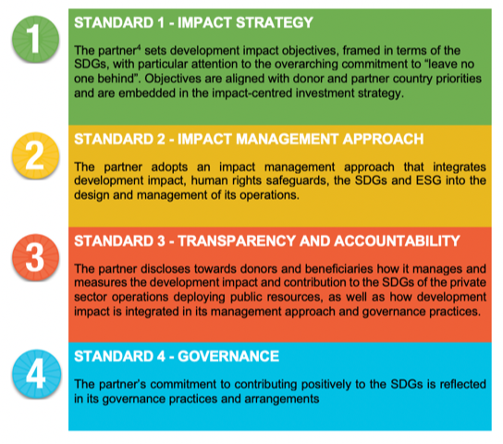
IS-FSD: 4 BUILDING BLOCKS
Notes:
Follow-up question => How can donors use the Standards to select partners?

Slide 35
STANDARD 2 – MANAGEMENT APPROACH: SUB-STANDARDS
S2 – The partner adopts an impact management approach that integrates development impact, human rights safeguards, the SDGs and ESG into the design and management of its operations.
Compliance with local and international legal frameworks
Stakeholders engagement
Monitoring and evaluation system
Exit management
Impact strategy refined through learning and improvement
Notes:
2.1 The partner assesses the investment’s compliance with local and international legal frameworks, including international human rights frameworks, when conducting both the due-diligence and ex-post impact assessment of investments. The partner also establishes criteria for investees’ integration of ESG factors and compliance with responsible business conduct (RBC) standards. The partner ensures that an independent functioning grievance and reparation mechanism is in place
2.2 The partner has effective processes to identify stakeholders affected (or likely to be affected) by its operations and implements a plan to conduct Meaningful Stakeholder Engagement ex ante, throughout the investment cycle (when circumstances change or when needed) and ex post.
2.3 The partner has a monitoring and evaluation system is place that is used to assess progress against impact targets and portfolio level impact goals, identify the partner’s contribution, and to identify areas for improvement. Adequate resources are provided for monitoring and evaluation, proportionate to the size of the investment.
2.4 The partner manages its exits from investments in a manner that optimizes sustained effects on development impact and contribution towards the SDGs post-exit
2.5 The partner periodically reviews and refines its impact-centred investment strategy and impact goals based on the learnings and evidence collected through monitoring and evaluation to guarantee that the impact strategy and goals remain fit-for-purpose in the changing development context.
Compliance with local and international legal frameworks
Stakeholders engagement
Monitoring and evaluation system – strategic use of evaluation
Exit management exits optimizing sustained effects on development impact
Impact strategy refined through learning and improvement

Slide 36
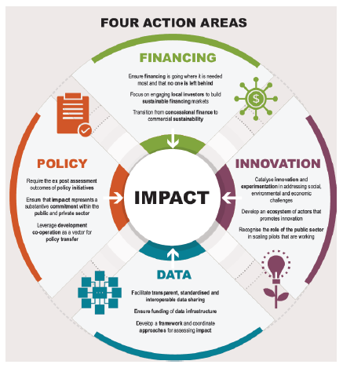
THE IMPACT IMPERATIVE

Slide 37
PORTUGAL
Strategic Concept for Development Cooperation 2014-2020:
“continue to support private sector development in partner countries, both by supporting a favourable business environment and by creating partnerships”
Main goals:
strengthen the capacity of local businesses;
mobilise private sector investments, and
leverage projects and funding in the area of corporate social responsibility.
Notes:
Portuguese private sector shall be the core partner in this partnership that is focused on investment, knowledge, capacity development, inclusive dialogue, collective, sustainable and transparent actions and that result-oriented principles will be used as a basis to define engagement and coordination strategies within the framework of the future Portuguese Cooperation Strategy for Private Sector Development
Main players:
Camões: creating “new business opportunities and also mobilise new financial resources to invest in development programmes
SOFID: financing products and services to the Portuguese companies investing in emerging countries
Camões is attempting to follow the recommendation of the organisation to design and implement a National Strategy for Private Sector in Development Cooperation.
The creation of a Working Group on Private Sector within the Development Cooperation Forum, bringing together the main stakeholders in the sector, in July 2018 was a first step attempting to look for opportunities to come up with joint initiatives. The Working Group has yet to meet.
Portugal. In the Strategic Concept for Development Cooperation 2014-2020, Portugal has committed to support private sector development in partner countries, both by supporting a favourable business environment and by creating partnerships. The main goals are: strengthen the capacity of local businesses, mobilise private sector investments and leverage projects and funding in the area of corporate social responsibility. The Portuguese private sector shall be the core partner in this partnership that is focused on investment, knowledge, capacity development, inclusive dialogue, collective, sustainable and transparent actions.
In the Strategic Concept for Development Cooperation 2014-2020, the main players for PSE in Portugal are:
Camões, the Portuguese Development Agency, responsible for creating new business opportunities and also mobilise new financial resources to invest in development programmes;
SOFID, the Portuguese DFI, responsible for financing products and services to the Portuguese companies investing in emerging countries.
Since 2014, Camões has signed a few protocols with Portuguese companies (e.g. the electricity utility EDP) to involve them in development cooperation initiatives.
SOFID is a limited liability company designed to support private investment in countries where a Portuguese interest can be identified. Its capital comes from the Portuguese State (~80%) but also from Portuguese banks (20%). Their investments must meet criteria for the SDGs and serve Portuguese interests. Their portfolio comprises loans to corporates and guarantees to local banks. SOFID has undertaken the process to complete pillar assessment to access EU funds via the European External Investment Plan.
AICEP is Portugal´s Trade and Investment Agency and assists Portuguese companies to invest and conduct business abroad, albeit only 14% of exports go to developing countries.
The Portuguese Government has also established the Lusophone Compact, a financing platform implemented by the African Development Bank providing risk mitigation, investment products and technical assistance to accelerate private sector development in Portuguese Speaking African countries

Slide 38
PORTUGAL
Ministry of Finance
Ministry of Foreign Affairs
80% ownership
Camões
SOFID
AICEP
Grants and guarantees
Loans and guarantees
Lusophone Compact
Development Cooperation Forum
Working Group on Private Sector
Guarantees and risk sharing
Notes:
Camões (Portuguese Development Agency)
Camões looking to sign protocols with Portuguese companies to involve them in development cooperation initiatives. A protocol with the main Portuguese electricity company, EDP, was signed on 24 June 2014 to develop projects focusing on access to energy within the framework of the UN Initiative Sustainable Energy for All and the European Strategy supporting universal access to energy. No joint projects appear to have started since the signature of the protocol.
Despite being formally the coordinator of Portuguese development cooperation, Camões is left out of early discussions and subsequent decisions related to development cooperation projects or programmes run by other public entities due to limited dialog and insufficient intra-governmental coordination.
SOFID (Portuguese DFI)
A limited liability company designed to support private investment in countries where a Portuguese interest can be identified.
Funding
Portuguese State (~80%) Portuguese banks (20% each)
Investments
Their investments must meet criteria for the SDGs and serve Portuguese interests. Currently, max investment of EUR 2.5 million per project
EUR 1 million of new annual commitments & 7 million in total portfolio
Instruments: 68% Loans, 32% Guarantees, one equity transaction. Loans were made to corporates for development projects and guarantees were applied to local banks to then lend in local currency at more favourable rates.
Mostly manufacturing, infrastructure, tourism and financial sectors
Staff of 14, Current operating budget is EUR 500,000 per year
SOFID undergoing an extensive effort to complete pillar assessment to access EU funds (via the European External Investment Plan), which it expects to complete by the end of Q1 2020. The EIB will provide SOFID with up to EUR 12m in a credit line designed to benefit small and medium-sized enterprises in Africa and the Pacific, which are underserved by the financial sector in the countries concerned. Portuguese SMEs and their subsidiaries in the targeted ACP countries are also eligible
The 2017 Survey by the OECD on the amounts mobilised by the private sector as a result of official development finance interventions shows that Portugal mobilised almost USD 94 million in 2012-17. Over 80% of the total amount mobilised by the private sector were directed to the Lusophone countries. SOFID mobilised over 90% of the total.
AICEP is Portugal´s Trade and Investment Agency and works with Portuguese companies of all sizes to export, invest and conduct business abroad as well as to attract foreign direct investment (FDI).
AICEP works with 15,000 registered Portuguese companies to assist in their international growth. It largely assists Portuguese companies in their export of products, which is dominated by exports to Europe – only 14% of exports go to developing countries.
Strong partnership with the AfDB through the Lusophone Compact, a financing platform providing risk mitigation, investment products and technical assistance to accelerate private sector development in Lusophone African countries. Portuguese Government allocated Eur 400m in guarantees and other risk sharing mechanisms in the 2019 National Budget

